Slide 1
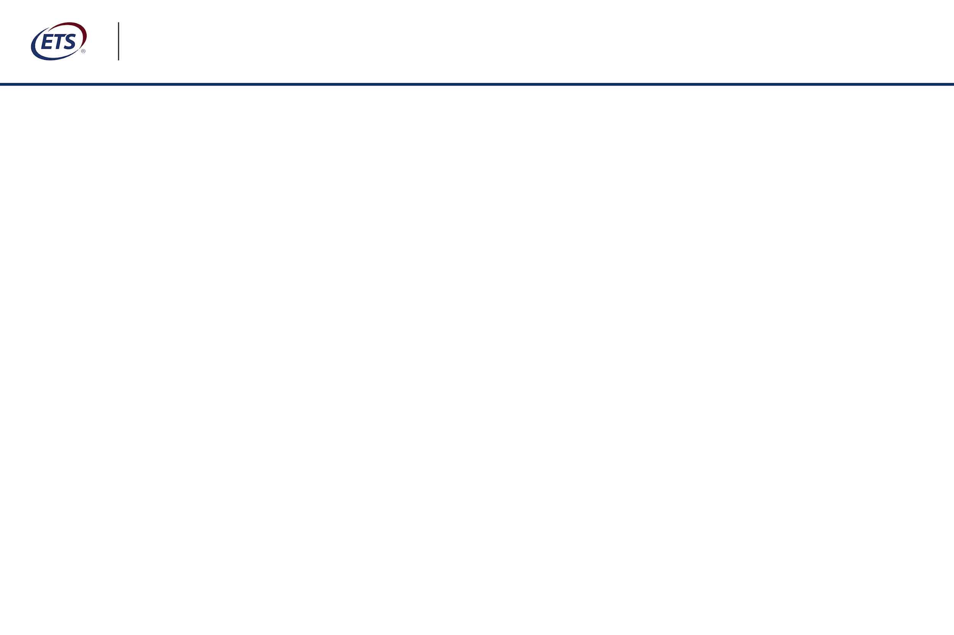

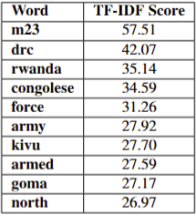
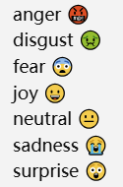
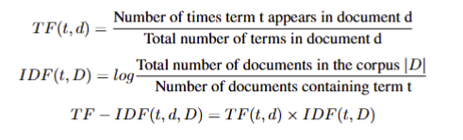
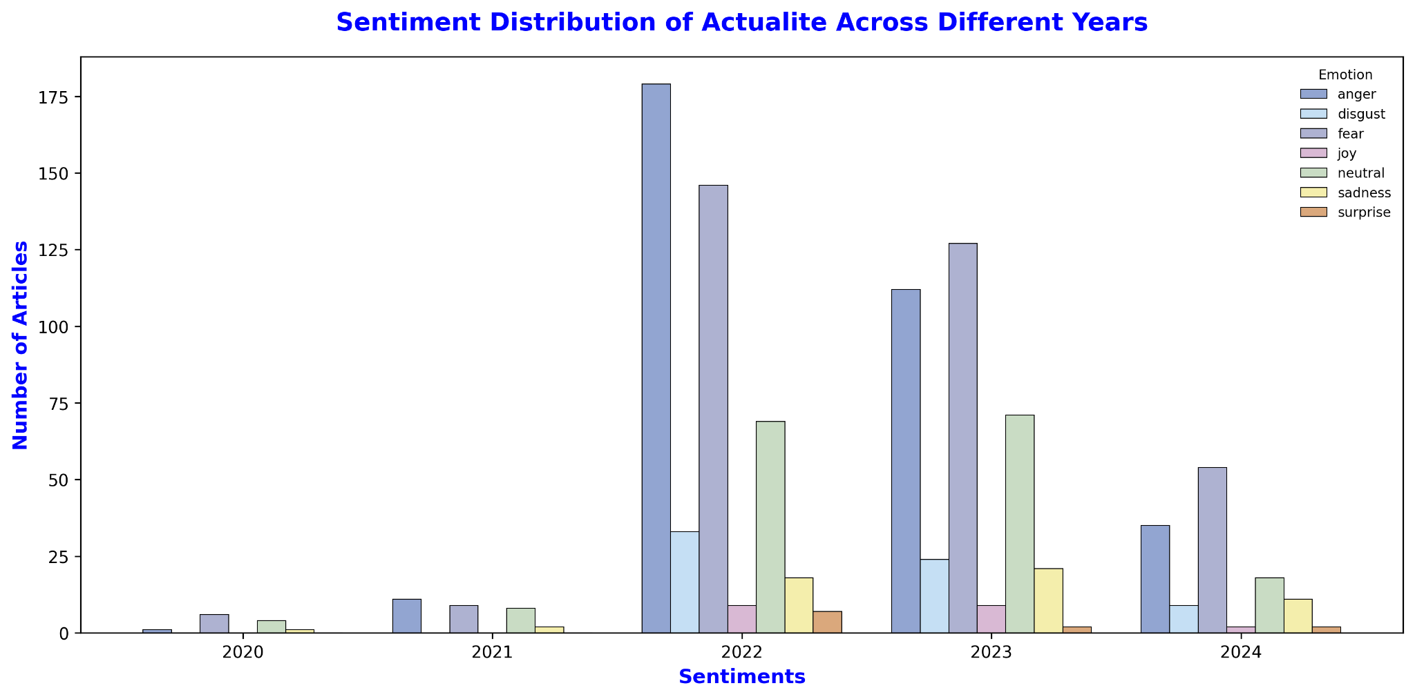
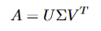
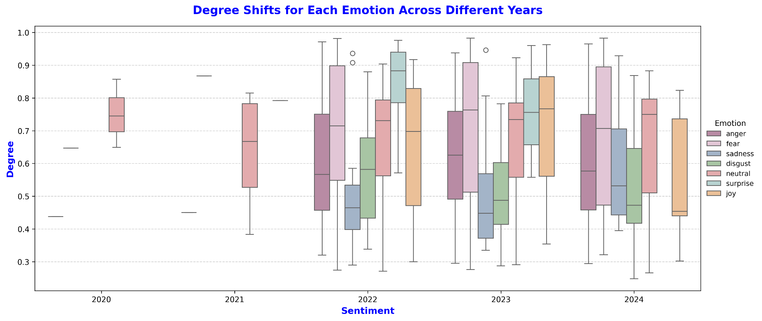




M23 Attacks: Public Sentiments Alternation in Congolese Newspapers Zeyu Han^{a,}*, John Quattrochi^{b}, ªGeorgetown University Data Science and Analytics Department, ^{b}Georgetown University Sociology Department
Abstract
Methods
The March 23 Movement (M23) rebel attack in November 2021 reignited disputation between the Democratic Republic of the Congo (DRC) and Rwanda, which was accused of sponsoring the hostile operations. Meanwhile, the Congolese public sentiments towards Rwanda changed rapidly as a manifestation of protest which was reflected in Congolese newspapers to a certain extent. This paper endeavors to leverage advanced large language models (LLMs) to perform sentiment analysis on various mainstream newspapers to investigate sentiments trends and emotion distributions to systematically understand sentiments shifts during the M23 rebel attack. We utilized BERT-based multilingual sentiment model to analyze the alternation of sentiment trends and degrees, and Distil RoBERTa sentiment model to identify specific emotions in journalistic articles. The sentiments shifts was corresponding to our initial hypothesis that state-run media would change sentiment the most to increase the support for the state. Additionally, we applied Term Frequency-Inverse Document Frequency (TF-IDF) and Latent Semantic Analysis (LSA) to discover significant terms and topics in Congolese newspapers. The prominence of "M23," "Goma," and "Rwanda" in the newspapers highlights the frequent association of the M23 attacks with Rwanda in public discourse.
Multilingual BERT/ DistiliRoberta: We use fine-tuned models from Google pre-trained BERT model to conduct sentiment analysis. Self-Attention mechanism is used to transfer textual data into vectors to calculate the probability of each sentiment.
Topic Modeling: We used TF-IDF to extract the 10 most significant words of articles among four newspapers. Then we leveraged LSA to figure out 5 most possible topics inside the newspapers.
The higher TF-IDF score represents the more important words in text.
Introduction
The LSA used Singular Value Decomposition to factorize term-frequency matrix into term-topic matrix, diagonal matrix of importance of each topic, and document-topic matrix.
The March 23 Movement (M23), primarily composed of ethnic Tutsi, was formed on 4 April 2012. They claimed that the government of Democratic Republic of the Congo (DRC) did not follow the 23 March 2009 peace agreement.
Although the negative sentiments such as “anger” and “fear” had a spike in 2022, the trend of these emotions was decreasing over time. On the one hand, private medias were supposed to relieve the tension for 2021 M23 rebel attack. On the other hand, the long term negative reports would use inciting words inevitably to trigger populism which is detrimental to social stability.
Results
Rwanda was accused to support M23 secretly to disturb the border of DRC for illegal appropriation of natural resources and threaten security of Goma and North Kivu.
The word “m23”,”drc”, and “rwanda” are the three most important words in Actualite newspaper.
“Anger” and “Fear” emotions have experienced the most significant surges following the 2021 M23 rebel attack.
We collected articles related to M23 from four different Congolese newspapers to explore the sentiment alternation since 2021 M23 rebel attack. Stata-run media RTNC has 48 samples, United Nations Affiliated media Radio Okapi has 1000 samples, and two most popular private medias in Twitter (X): Actualite has 1000 samples and 7SUR7 has 603 samples.
Conclusions
The study employed sentiment analysis and topic modeling to explore the public concerns and sentiment shifts reflected in Congolese newspapers during the 2021 M23 rebel attack period. The sentiments expressed in newspapers could partially represent the public sentiments tendency.
The topic words revealed underlying public sentiments, reflecting a collective demand for a strong government response to Rwanda and M23 even through military action.

Slide 2
M23 Attacks: Public Sentiments Alternation in Congolese Newspapers

Slide 3
Presentation Structure
Generally, our presentation will be broken down as:
Background
Research Question
Datasets
Research Methods
Result
Discussion and Conclusion

Slide 4




The March 23 Movement (M23)
M23 is an rebel military group in Democratic Republic of the Congo (DRC) formed in 2012.
Mainly composed by Tutsi, a common ethnicity in both DRC and Rwanda.
A continuation of the National Congress for the Defence of the People (CNDP)
Primarily active in North Kivu, with a particular focus on city of Goma.
Rwanda was accused to support M23 secretly although its government denied.
M23 violated the peace agreement in 2013 and reignited the rebel attack in 2021 which caused a massive humanitarian crisis.
https://upload.wikimedia.org/wikipedia/en/9/90/Logo_of_the_March_23_Movement.png
Support Secretly
Fight Against
https://ih1.redbubble.net/image.3951154055.6190/st,small,507x507-pad,600x600,f8f8f8.u4.jpg
https://www.economist.com/cdn-cgi/image/width=1424,quality=80,format=auto/content-assets/images/20240727_MAP002.jpg
https://upload.wikimedia.org/wikipedia/commons/9/9c/Coat_of_arms_of_the_Democratic_Republic_of_the_Congo_%28black_spear%29.svg

Slide 5
Dataset
Textual Data from State-run Media, United Nations Affiliated Media, and Private Medias from 2020 to 2024 about M23 and Rwanda
State-run Media: Radio et Télévision National Congolais (RTNC) contains 48 articles
UN Media: Radio Okapi contains 1000 articles
Private Medias:
Actualite.CD contains 1000 articles
7SUR7.CD contains 603 articles
https://upload.wikimedia.org/wikipedia/commons/a/ad/ActualiteCD_Logo.png
https://i.pinimg.com/736x/d4/f2/36/d4f2367f52d84873a51d138992f8112c.jpg
https://za.radio.net/300/radiookapi.png?version=4d4929b8a673460fa98882b15cac8615
https://7sur7.cd/sites/default/files/inline-images/LOGO_7SUR7_FOND_NOIR_2%20copie.png

Slide 6

Aim of Research
To explore the public sentiments alternation after 2021 M23 rebel attack through various mainstream newspapers.
To extract the potential popular topics among all newspapers to understand public concerns and potential public sentiments.
https://roxhillmedia.com/wp-content/uploads/2024/11/Sentiment-Analysis-The-Power-of-Media-Monitoring.png

Slide 7
Research Method
NLP Based Techniques
Fine-tuned LLMs Sentiment Analysis
Feature Extraction of Textual Data
Large Language Models can handle multiple natural language processing tasks such as sentiment analysis and text generation for long sequence.
Feature extraction usually involves considering semantic and syntactic structures of text to capture the meanfuling words.

Slide 8

Sentiment Analysis
Multilingual Bert
Classify 5 sentiment labels from very negative to very positive, could handle maximum 1024 sequence length.
Transform text data into vector representations and apply self-attention mechanism to calculate the probability of sentiment label to each article.
https://cdn.prod.website-files.com/614c82ed388d53640613982e/64f7989c55786e5b4de9b9cb_sentiment-analysis-explained.webp
DistiliRoberta
Classify 7 specific emotions including anger, fear, disgust, sadness, neutral, surprise and joy.
As an english-based model, so we used Google translate API to translate French articles into English text for better performance of model.

Slide 9
Result 1: Sentiment Distribution and Degree Alternation
Taking Actualite newspaper as an example, after 2021 M23 rebel attack:
The number of articles representing fear and anger had a surge in 2022 and continued to decrease following the time.
The degrees of fear and anger remains small changes from 2022 to 2024.
The sadness degree had an increasing trend from 2022 to 2024.

Slide 10
Feature Extraction
Term Frequency- Inverse Document Frequency
The stopwords such as “am”, “a”, “the” have been removed from the text before applying TF-IDF
Lemmatization to transfer all vocabulary into original version, for example, transferring “loves” to “love”
All features have corresponding TF-IDF score, and higher score means more importance
Latent Semantic Analysis
LSA utilizes singular value decomposition to reduce dimensionality of text to discover the potential topics
Applied stopwords elimination and lemmatization before deployment
Finding multiple topics with setting hyperparameter k

Slide 11
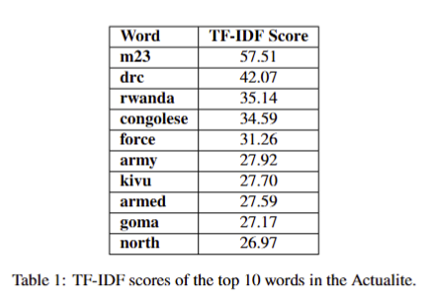
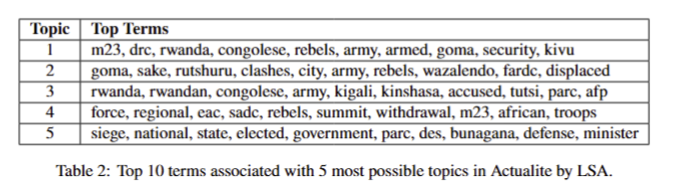
Result 2: Significant Words and Topics
“m23”, “drc”, and “rwanda” are the top 3 most significant words with highese TF-IDF score. Subsequently, “army”, “force”, and “armed” are frequently occurred to represent the “anger” emotion among Congolese to call for a powerful government .
“army”, “rebel”, and “troops” words in topics from LSA indicate that DRC government and Rwanda had long-term tensions and indirect contradictions about national security since 2021 M23 rebel attack.

Slide 12
Discussion and Conclusion
The study employed sentiment analysis and topic modeling to explore the public concerns and sentiment shifts reflected in Congolese newspapers during the 2021 M23 rebel attack period. The sentiments expressed in newspapers could partially represent the public sentiments tendency.
The topic words revealed underlying public sentiments, reflecting a collective demand for a strong government response to Rwanda and M23 even through military action.
We explored the four newspapers of DRC and applied two Bert based LLMs to deploy sentiment analysis for articles. We recommend that researchers could expand the sources and leverage the more advanced LLMs such as GPT series to get more diverse and comprehensive results.

